Slide 1
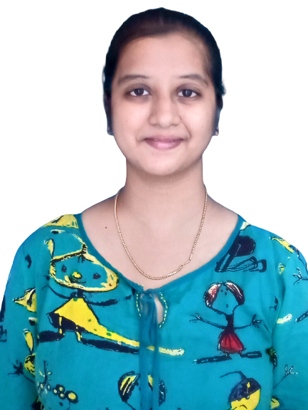



Siva Priya Palakurthi
Analyst/Software Engineer
Bachelor of Information Technology
Information Technology : 2015 -2019
Skills
BANGALORE
siva-priya.palakurthi@capgemini.com
C# | Basics, OOPS, Exception Handling, Collections & Generics, Delegates, Events , File IO and Serialization
.NET Framework | ADO.NET with Entity Framework And LINQ,ASP.NET with MVC5, ASP.NET CORE WEB API.
ADO.NET | Basics, Connected and Disconnected Architecture
RDBMS | Basic And Advanced Using SQL Server, Oracle.
UI Technology | HTML 5, CSS And JavaScript
Tools | Git ,GitHub, IDE , Visual Studio, SSMS
Add On Skills | Communication , Team management, Smart Work
7816033687
A4
Full Stack Developer
• Hands on experience on C#,ADO.NET,LINQ,Entity framework,Sql Server,ASP.NET MVC5 with WEB API,ASP.NET CORE WEB API.
•Good Knowledge of java programming.
•Good in developing web pages using HTML, CSS.
•Currently learning on iTransform-Microsoft .Netcore and Azure fundamental
• Full Stack developer with React and Full Stack .NET Developer
• Hands on experience in developing web pages using HTML5, CSS3, Object Oriented Java script, TypeScript, ES6, JSON, XML. Good understanding of Document Object Model (DOM) and DOM Functions.
• Proficient in creating Single page Web Application in React with Authentication with routing.
ONLINE RAILWAY RESERVATION SYSTEM
Case study of Online Railway Reservation System along with API Gateway, Swagger,responsive UI with HTML5, CSS, Bootstrap and React used as User Interface.
Three layered architecture which includes a Data Access Layer, Business Logic Layer using C#, ASP.NET CORE WEB API. , SQL Server . Exception Layer handled the exceptions.
Classes in all layers were designed using C# and ASP.NET CORE WEB API. Database was designed in SQL Server.
Connecting the application with database was done using ASP.NET CORE WEB API.
Check out my work on GitHub

